Slide 1
COVID19 Testing Management System

Slide 2
Abstract
Nowadays, COVID19 Testing Management System is one of the most essential tools that are mostly used in Testing Lab; it is mostly used to manage COVID19 medical lab related activities.
In this project we tried to develop a computerized and web based COVID19 Testing management system. Our main intention is to allow this application to be used in most retailing COVID19 lab, where a small point of customization will be required to each COVID19 lab in the implementation period. This system is designed to overcome all challenges related to the management of diagnostic that were used to be handled locally and manually.
The system is an online COVID19 lab manager application that brings up various COVID19 test working online. Using this system, it will help us to records all transaction made at the daily tests; recognize all customers, employees, etc. It will manage all activities around the COVID19 lab that increases productivity and maximize profit, it will also minimizing the risk of getting loss because all transactions are recorded to the system.

Slide 3
Introduction
COVID19 Testing Management System is web based technology which brings up various diagnosis works online. Here patients are first allowed to register on the website and provide personal, test information. Once registered with their address and contact details, the patients may now see a variety of tests conducted by the lab. The patient will select the required test and book appointment after that lab center send a lab boy at registered address to collect a sample. After successful sample collection patient can track their test history using the name, order and registered mobile number. The system allows admin to attach a copy of the report into the system and automatically shown on user side so user can downloads report.
In COVID19 Testing Management System we use PHP and MySQL database. It has three modules i.e.
Admin
User (Patient)

Slide 4
Admin Module
Admin is the super user of the website who can manage everything on the website. Admin can log in through the login page
Dashboard: In this section, the admin can see all detail in brief like the total, assigned and the sample collected and completed tests.
Phlebotomist: In this section, the admin can manage Phlebotomist (add, update, delete).
Testing: In this section, the admin can manage all the tests like assign the test to Phlebotomist and update the history.
Report: In this section, the admin can generate two types of report. One is between dates reports and another one is by search. Admin can search the report by order number, name and mobile number.
Notification: In this section, the admin will get a notification for every new test request (notification bell).
Admin can also update his profile, change the password and recover the password.

Slide 5
User (Patient) Module
User can visit the application through a URL.
Testing: This section divided into two parts. One is for new user and another one is for registered user. New user (First-time user) needs to provide personal and testing Information. A registered user only needs to provide test information; their personal information will be fetched from the database.
Report: In this section, Users can search their test report using order number, name and registered mobile number.
Dashboard: In this section, the User can see the in which State of how many tests are done.

Slide 6
Scope
Today also we have to go to the COVID19 Test Lab center, wait in the queue to get our COVID19 test done. As Technology is growing rapidly we are also moving to a technical world where everything we want to be online. So with the help of this project we are bringing the use of technology in the field of medical diagnosis where patients can avail all the diagnosis facilities at their door steps. This project makes the diagnosis process easy and reduces the burden of patients. At a same time its help the diagnostic center to track all their patients details with their test reports. This access friendly software provides quick and effective services which helps the diagnostic center to increase their sales and profit.
Advantages:
The system allows automate diagnosis system.
Allows for faster service.
Allows increased sales and profits for diagnostic labs.
Easy, user friendly GUI.
Validation of data will be ensure only accurate valid and complete data stored in the database.
Easy retrieval or data will be made possible by finding techniques.
Report generation will help made it easy to analyze the performance.
Disadvantages:
It reduces employment as the human efforts are being automated by this system.

Slide 7
Requirement Specification
Hardware Configuration:
Client Side
Server Side
RAM | 512 MB
Hard Disk | 10GB
Processor | 1.0 GHz
RAM | 1 GB
Hard Disk | 20GB
Processor | 2.0GHz

Slide 8
Continue.....
Software Requirement:
Client Side
Server Side
Web Browser | Google Chrome or any compatible browser
Operating System | Windows or any equivalent OS
Web Server | APACHE
Server side Language | PHP5.6 or above version
Database Server | MySQL
Web Browser | Google Chrome or any compatible browser
Operating System | Windows or any equivalent OS

Slide 9
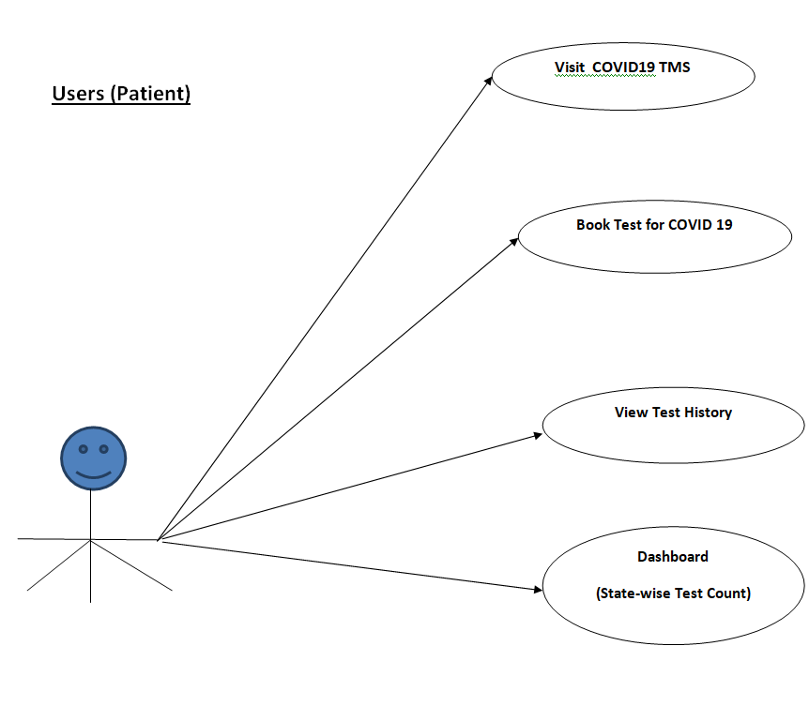
Use Case Diagram
Notes:
USECASE DIAGRAM: A Use case is a description of set of sequence of actions. Graphically it is rendered as an ellipse with solid line including only its name. Use case diagram is a behavioral diagram that shows a set of use cases and actors and their relationship. It is an association between the use cases and actors. An actor represents a real-world object. Primary Actor – Sender, Secondary Actor Receiver.

Slide 10
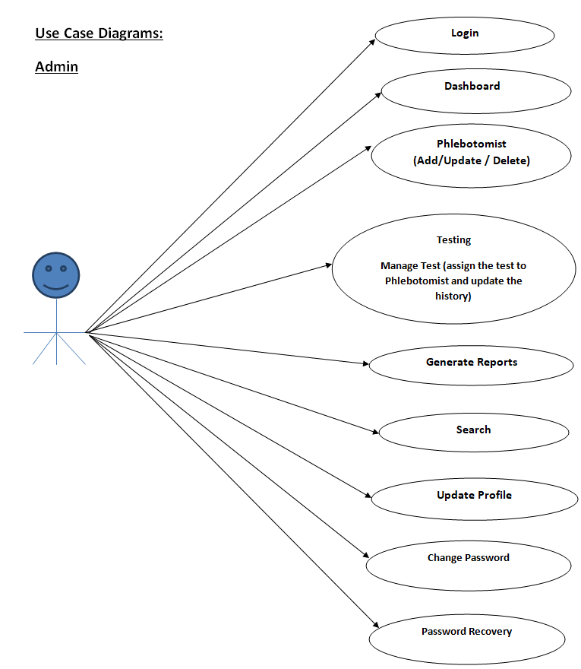
Continue.......

Slide 11
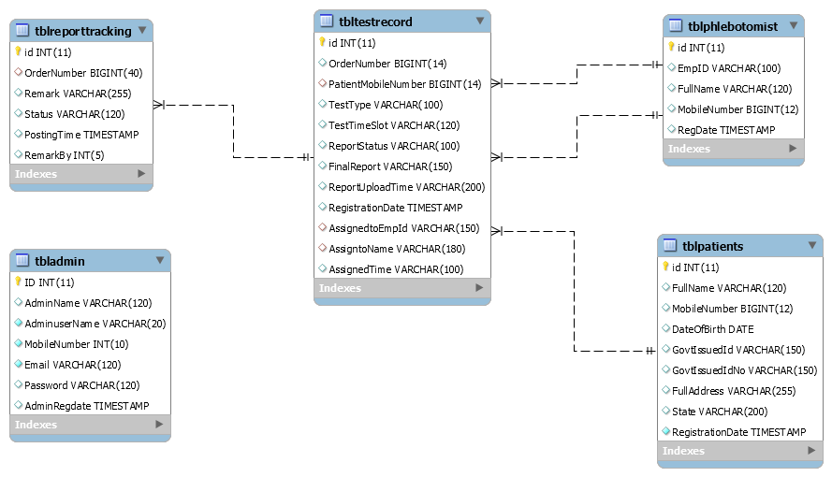
Class Diagram
Notes:
Class Diagram:
A description of set of objects that share the same attributes operations, relationships, and semantics

Slide 12
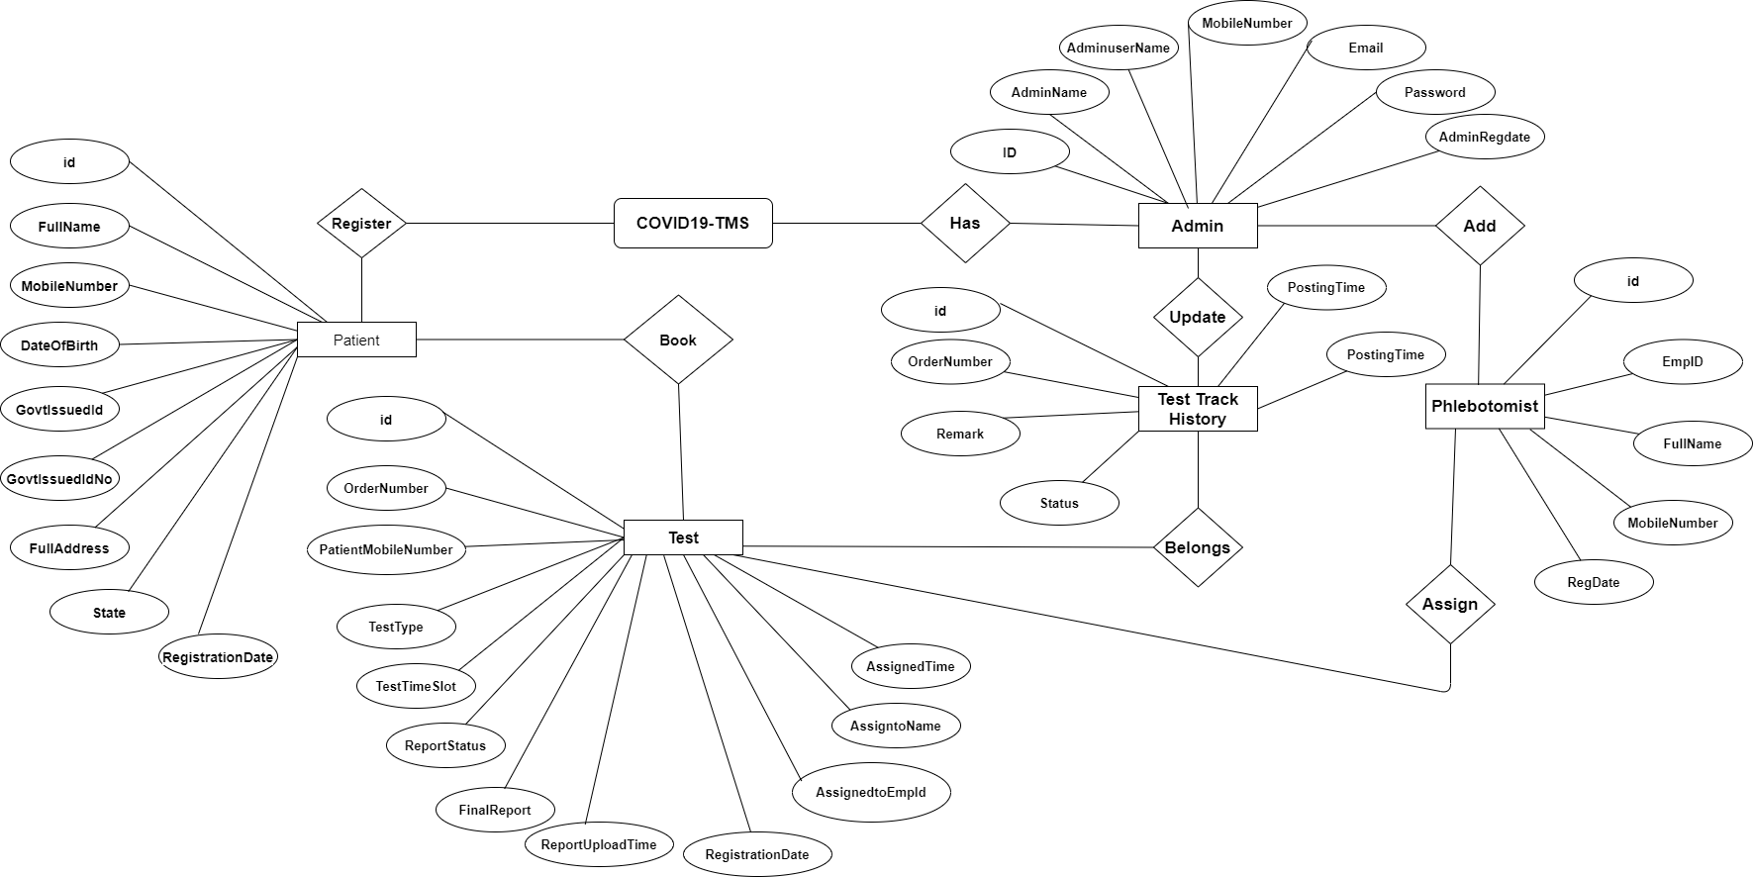
ER Diagram

Slide 13
Implementation and System Testing
After all phase have been perfectly done, the system will be implemented to the server and the system can be used.
System Testing
The goal of the system testing process was to determine all faults in our project .The program was subjected to a set of test inputs and many explanations were made and based on these explanations it will be decided whether the program behaves as expected or not. Our Project went through two levels of testing
Unit testing
Integration testing

Slide 14
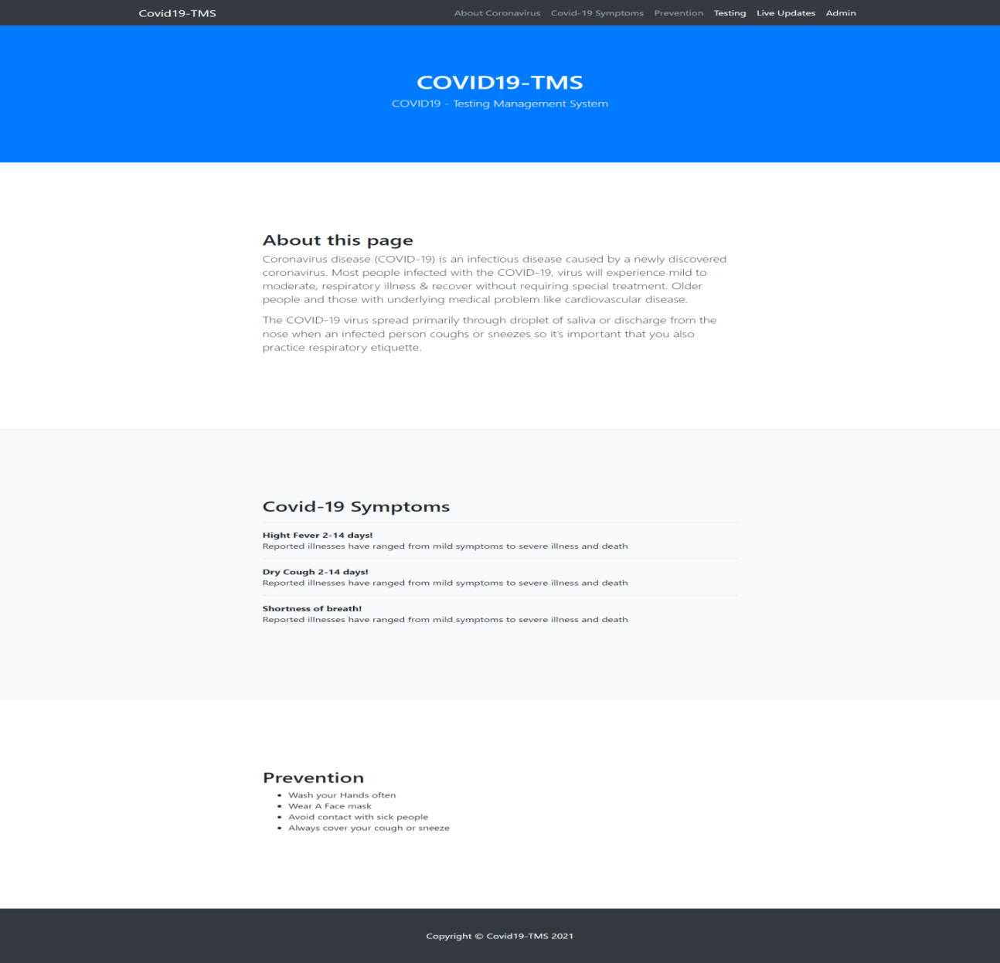
Evaluation

Slide 15
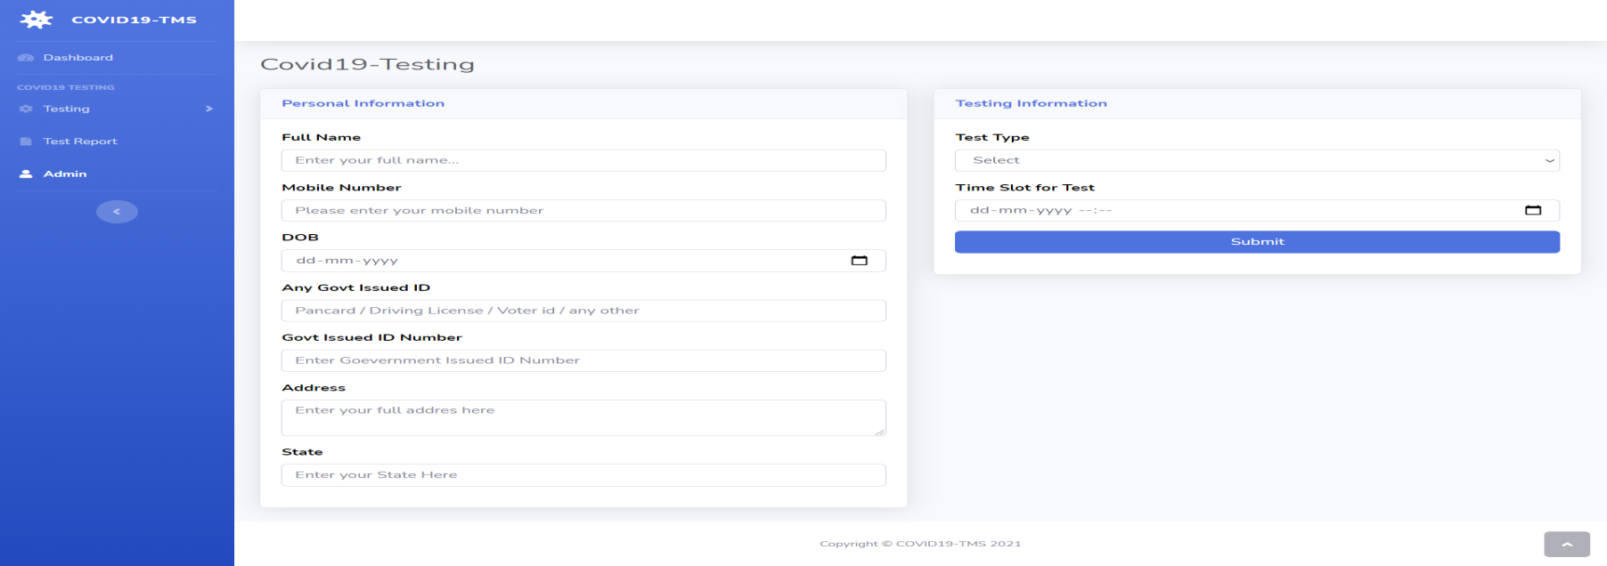
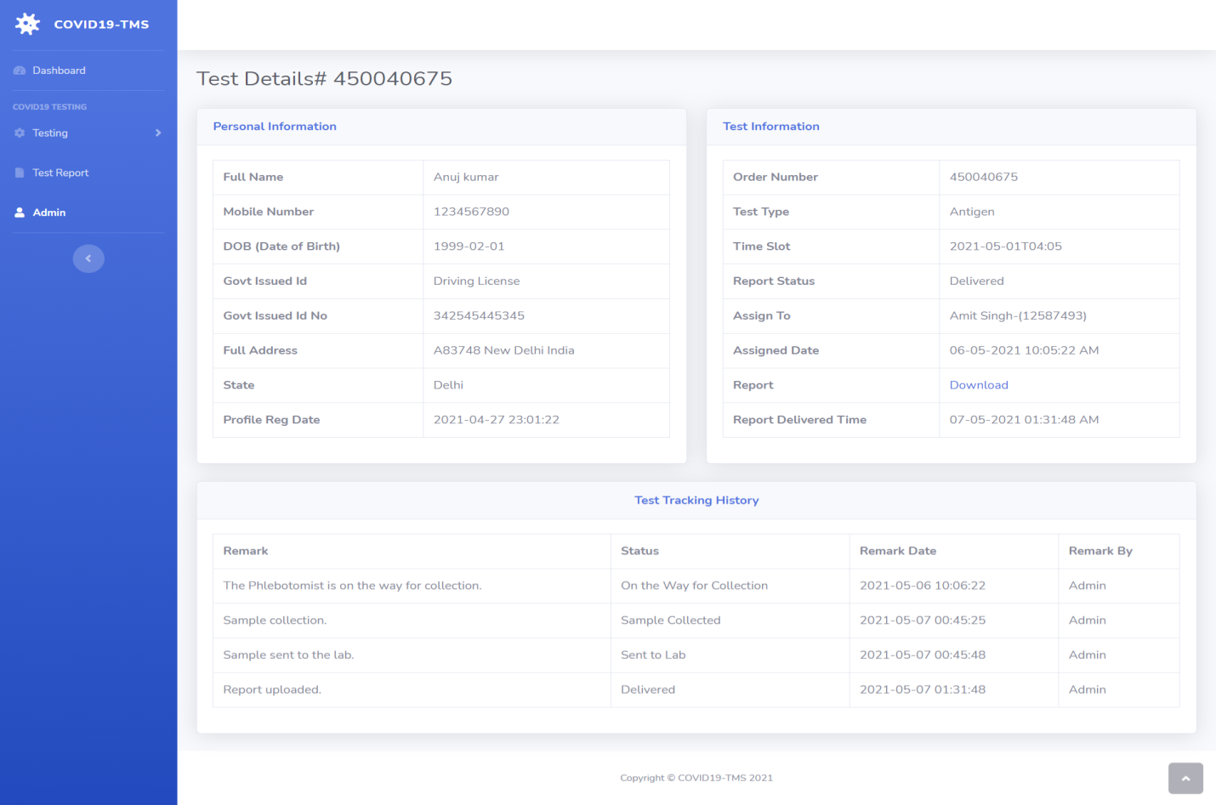

Slide 16
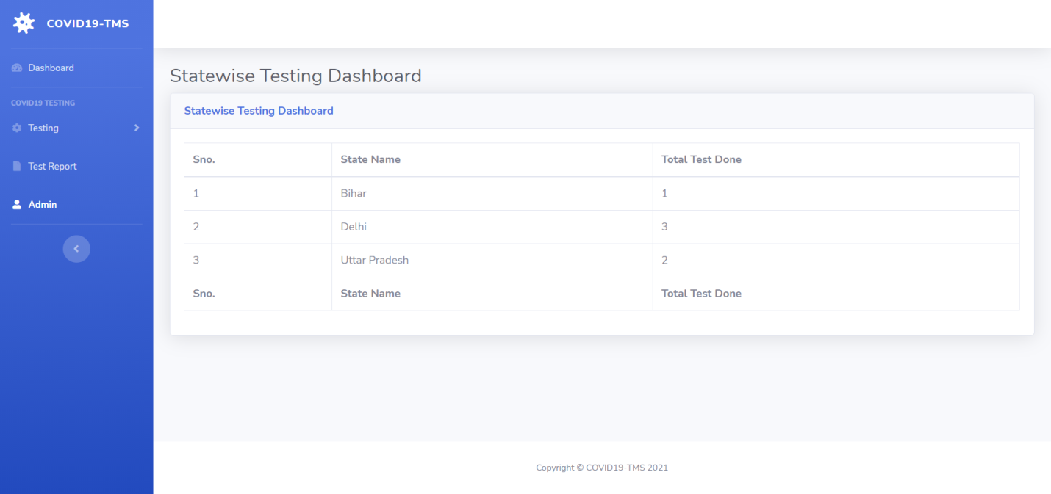
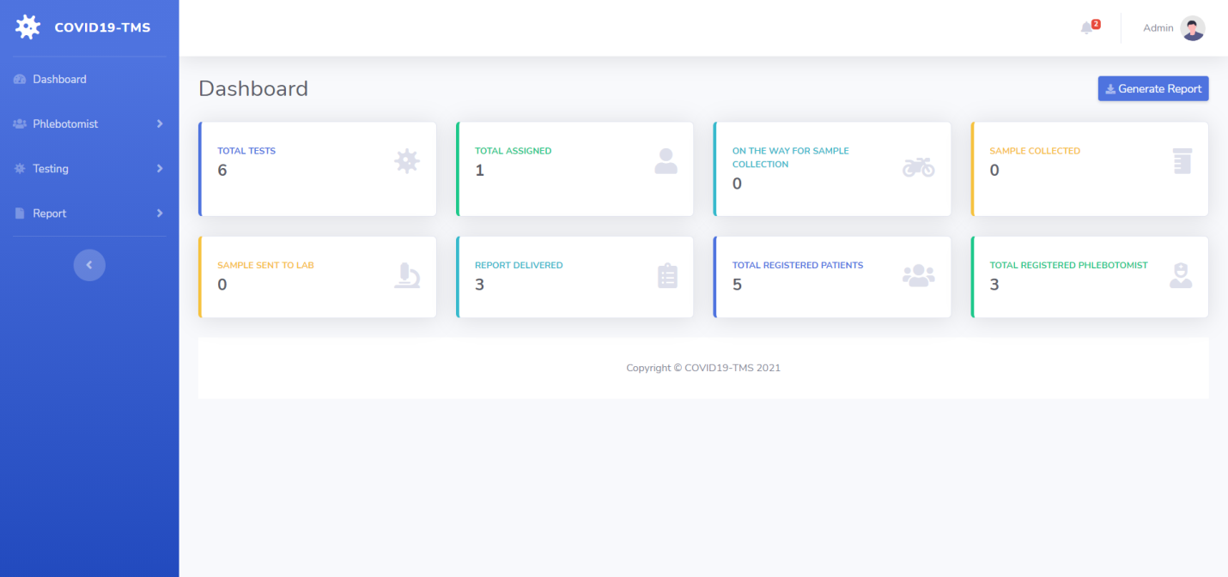

Slide 17
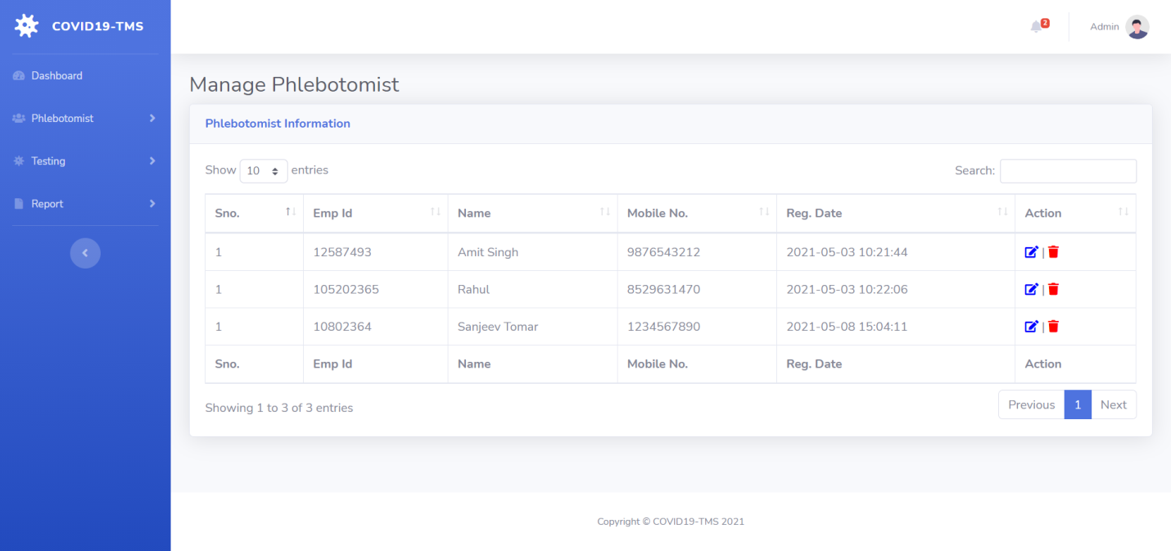
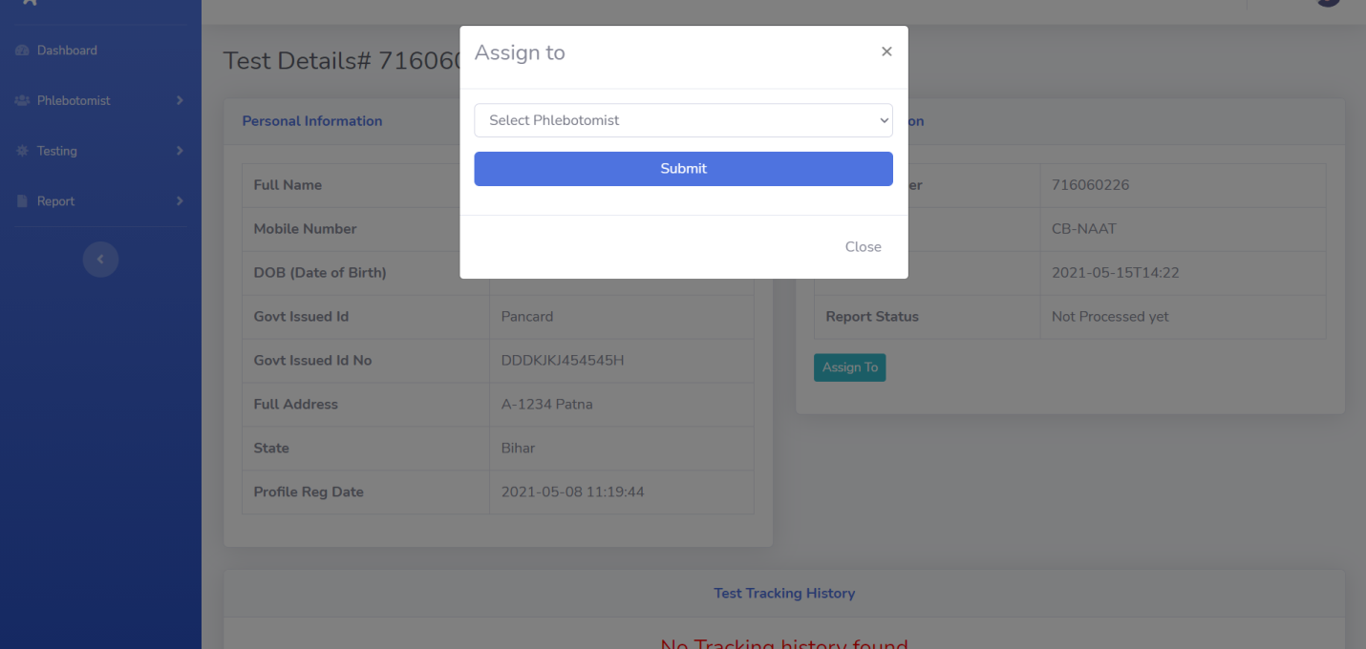

Slide 18
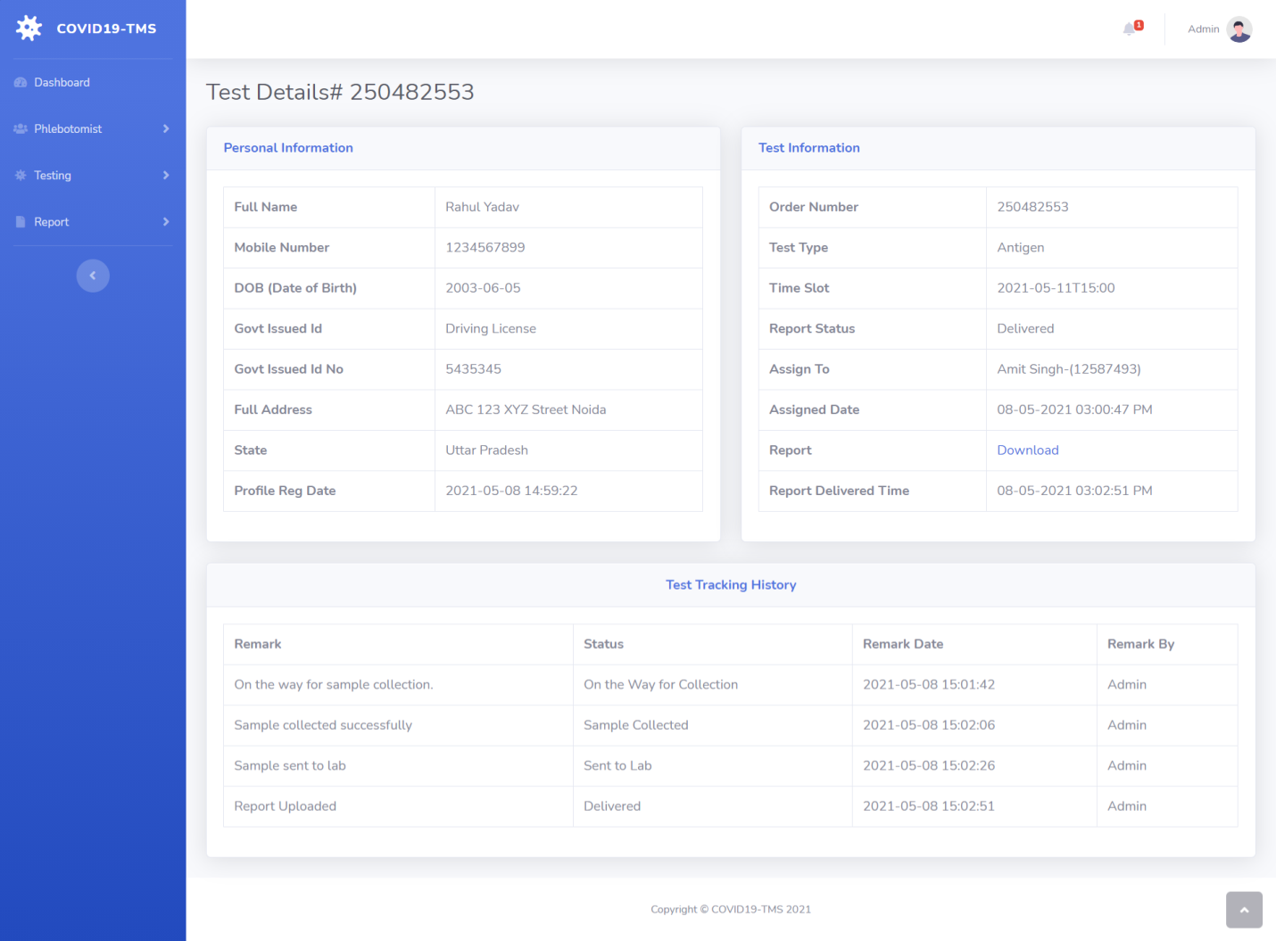

Slide 19
References
For PHP
https://www.w3schools.com/php/default.asp
https://www.sitepoint.com/php/
https://www.php.net/
For MySQL
https://www.mysql.com/
http://www.mysqltutorial.org
For XAMPP
https://www.apachefriends.org/download.html

Slide 20
Thank You

